Slide 1

MUSIC STORE Database
GROUP MEMBERS-
HARMANPREET
VINEETH VERMA
SANDEEP SINGH

Slide 2

Contents
Introduction
Design and modeling
Classification
Database interaction
Data entries
Backup and restore
General queries
Specific queries
Conclusion

Slide 3

INTRODUCTION
The music store database is an online store that has a collection of music albums of many artist.in this music store database there are seven tables and three linking tables.The music store database is an online music store that display the data about the albums such as no of albums, instruments used in the albums, orders total in the store and the data related to the music album i.e., release date, sold items, available items, discount, purchases, name of the artist, price etc.

Slide 4
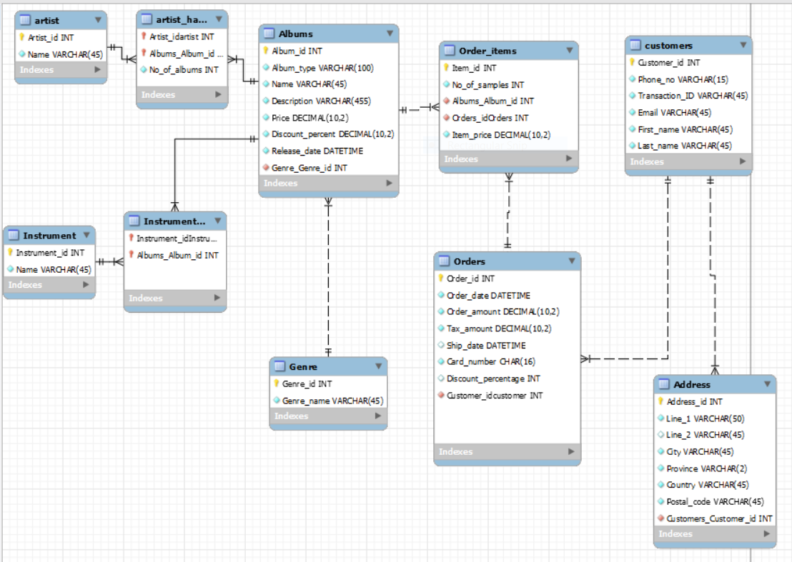
DESIGN AND
MODELING

Slide 5
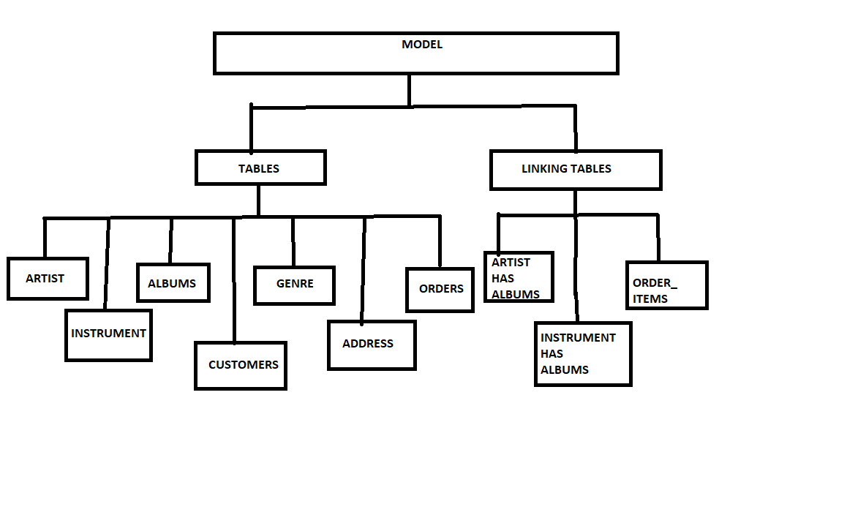
CLASSIFICATION

Slide 6
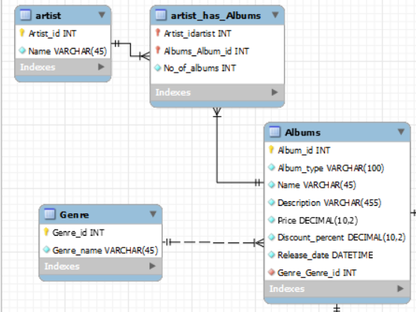
Primary keys-
Artist_id INT
Album_id INT
Genre_id INT
Foreign Keys-
Artist_idartist INT
Albums_Album_id INT
Genre_Genre_id iNT

Slide 7
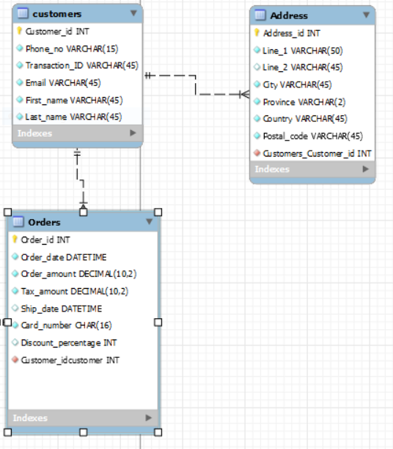
Primary keys- Customer_id INT ,
Address_id INT
Order_id INT
Foreign keys-
Customers_Customer_id
INT
Customer_idcustomer
INT

Slide 8
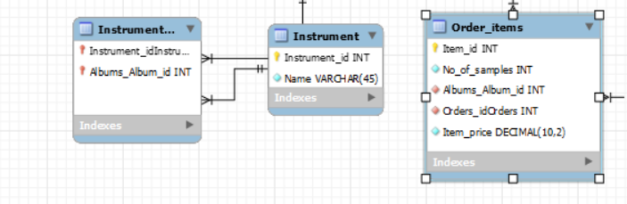
Primary keys- Instrument_id INT, Item_id INT
Foreign Keys- Instrument_idInstrument , Album_Album_id INT, Orders_idOrders INT

Slide 9
DATABASE INTERACTION
After designing a E-R diagram the next step is to convert the diagram into script .
The script can be created by using the mysql workbench automatic feature.
By using file > export > forward engineer SQL CREATE SCRIPT we can easily convert a model into a script.

Slide 10

DATA ENTRIES
After getting a script from model the next step is to add a data into tables.
For adding the data, we can manually add the data by selecting the table from the schema in the navigator.

Slide 11
BACKUP
After adding all the entries in tables, the next step is to create a backup of our database.
for that we have to follow some steps:-
Connect to your MySQL database.
Click Server on the main tool bar.
Select Data Export.
Select the tables you want to back up.
Under Export Options, select where you want your dump saved.
Click Start Export.
You now have a backup version of your site.

Slide 12
GENERAL QUERIES
1-Display a list of clients that spent more than the average spent by client in the past month

Slide 13
2-The top sold products and least sold products over a week.

Slide 14
3-The top sold products and least sold products over a week.

Slide 15
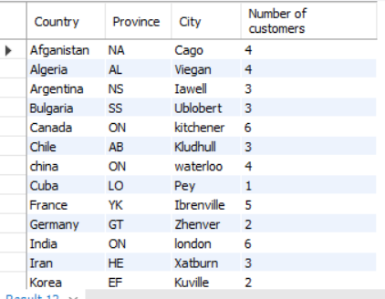
4-List how many customers the system has by location (Country, Province, and City), and then sort them.

Slide 16
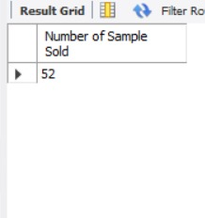
5-List how many products the store has sold for a particular month.

Slide 17
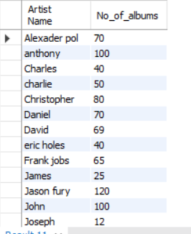
6-List how many distinct albums each singer has.

Slide 18
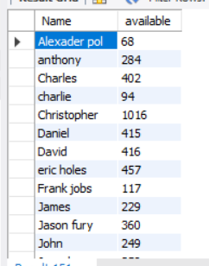
7-List how many copies of an album are available of a particular singer.

Slide 19
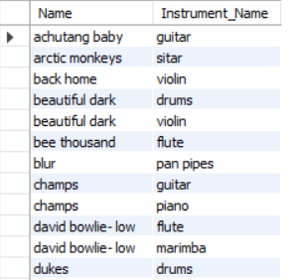
SPECIFIC QUERIES
Filter albums according to instruments used in the album.

Slide 20

2-Most popular instrument.

Slide 21

THANK YOU

